Slide 1
Resolving latency issues of the message flow and implementing the
data persistence layer (IndyCar)
Sahaj and Ishneet
April 29th 2019

Slide 2
Introduction
Implementing and comparing Message Broker Software Platforms
(RabbitMQ, Apache Apollo)
Implementing Data Persistence Layer (MongoDB)
  Persist results of anomaly detection for offline analysis.
  Persist historical data of racing events to support query and analyzing
Data Set
Previous Log Files which contains real-world data collected from Indianapolis 500 series races and practice sessions.

Slide 3
Related Work
Dobbelaere, P., & Esmaili, K. S. (2017, June). Kafka versus RabbitMQ: A comparativestudy of two industry reference publish/subscribe implementations: Industry Paper. In Proceedings of the 11th ACM International Conference on Distributed and Event-basedSystems (pp. 227-238). ACM.
John, V., & Liu, X. (2017). A Survey of Distributed Message Broker Queues. arXiv preprint arXiv:1704.00411 .
Jain, V.J., & VIT (2017). MongoDB and NoSQL Databases.
Methodology
Data Streamed from the log files and is published into the message broker
Filtering of Data based on parameters
Data is now dequeued into the MongoDB database as well as into Apache Storm for anomaly detection.

Slide 4
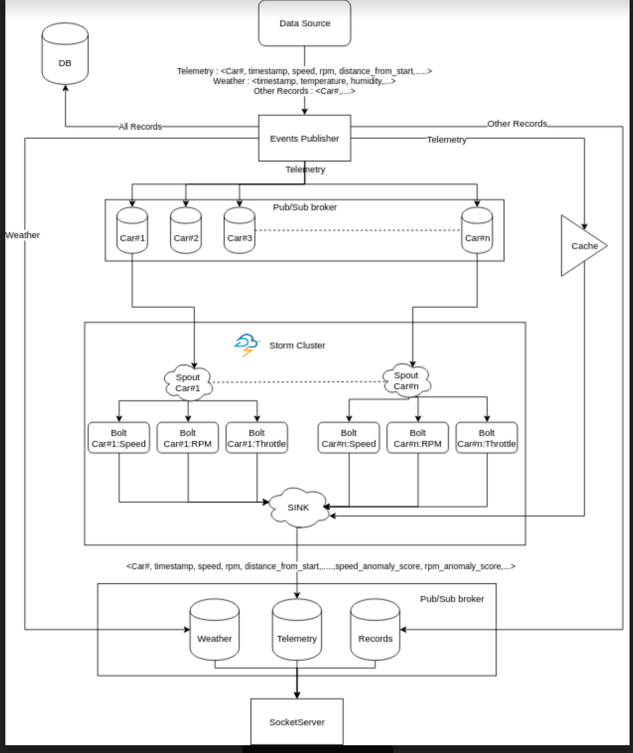
Methodology
Anomaly scores are passed through the broker and stored in the database.
Stored data can now be used for Analysis.

Slide 5
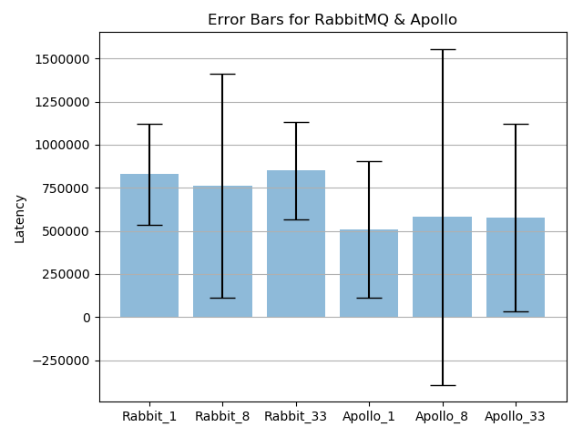
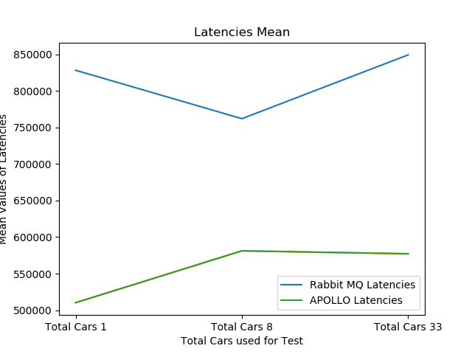
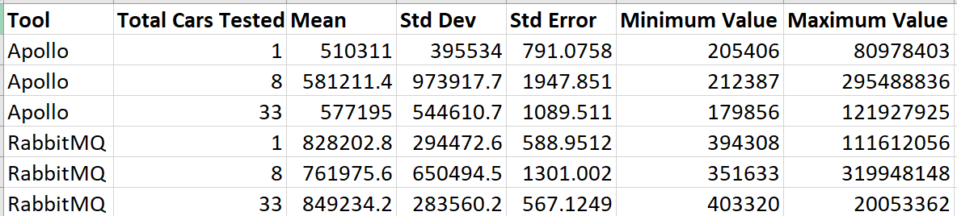
Experiments
Calculating the Latencies for
Apache Apollo and RabbitMQ

Slide 6
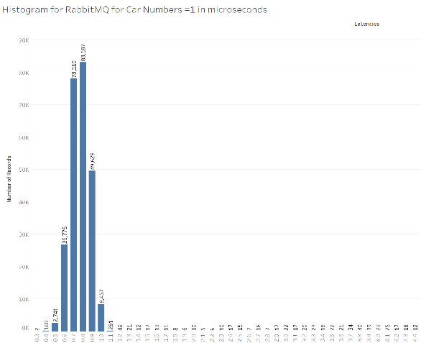
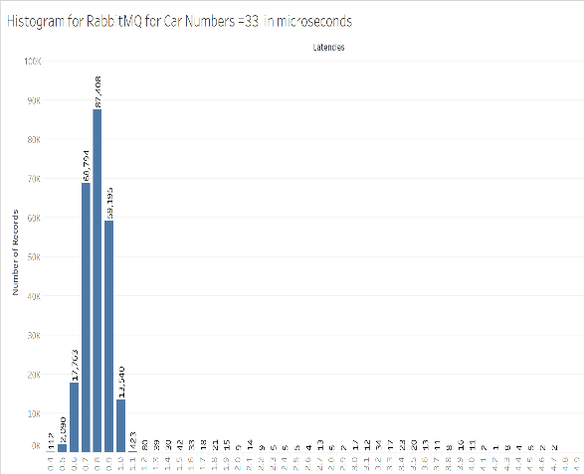
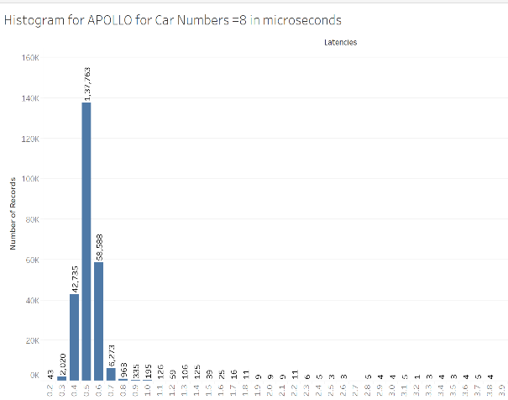
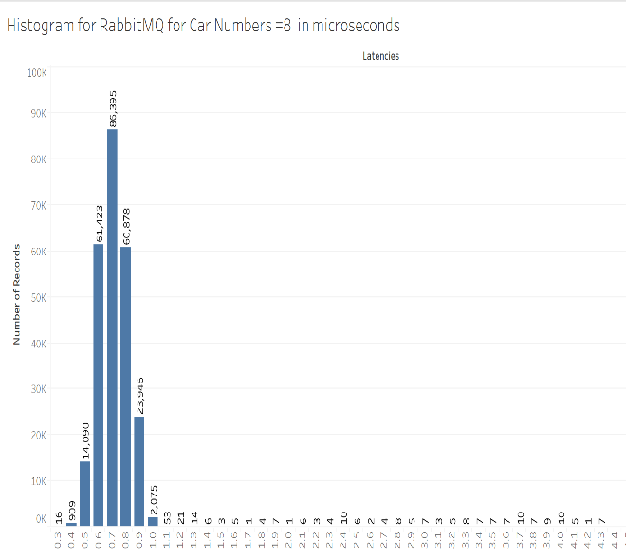
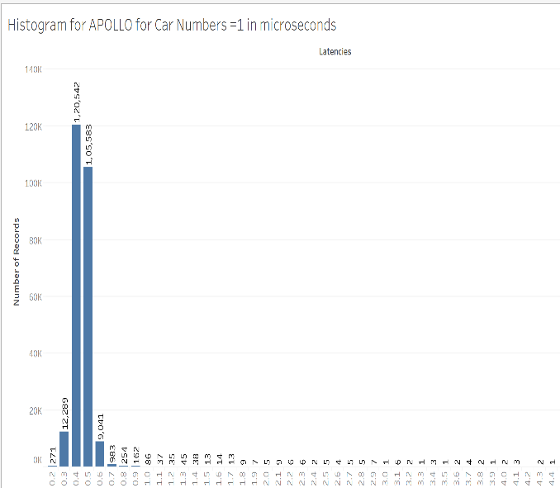
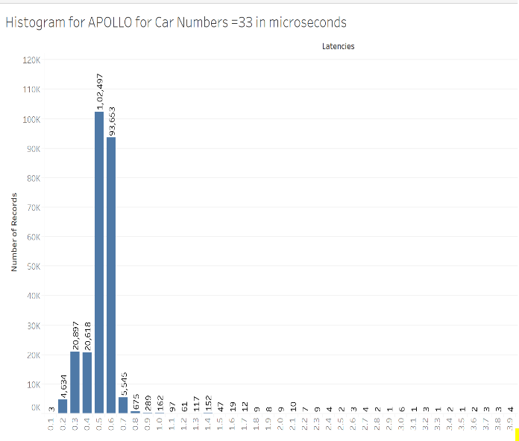

Slide 7
MongoDB Data Persistence Layer-
Collections Created-
1.CompletedLaps
2.EntryInfo
3.FlagInfo
4.OverallResults
5.RunInfo
6.TrackInfo
7.telemetry
Modules Created for querying data-
1.DriverService
2.RaceService
3.TrackService

Slide 8
DriverService Module-
-getAll()
-getDriverByRace(int race_id)
-getDriver(String driver_id)
-search(String partial_name)
-getLapRecords(int race_id, String car_num)
TrackService Module-
-getAll()
-getTrack(String Track_name)

Slide 9
RaceService Module
-getAll()
-getRace(int race_id)
-getFlags(int race_id)
-getRanks(int race_id)
-getsnapshot_final(int hours, int minutes, double seconds, int race_id, int threshold_in_seconds)

Slide 10
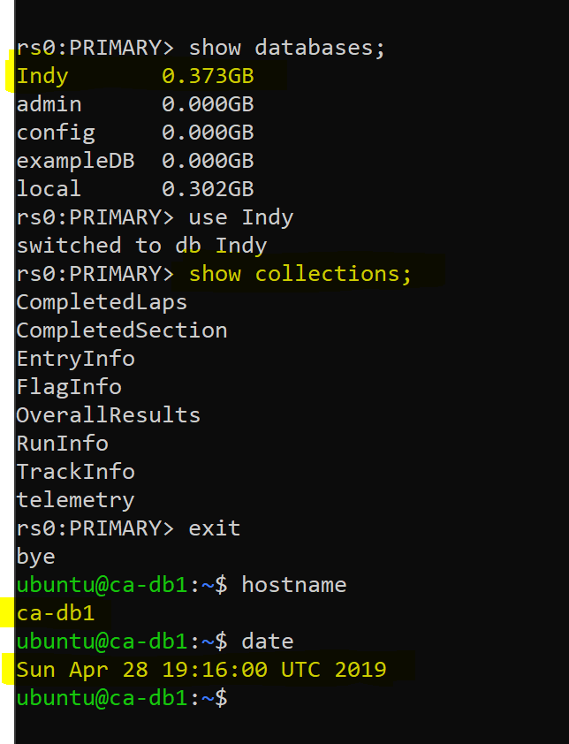
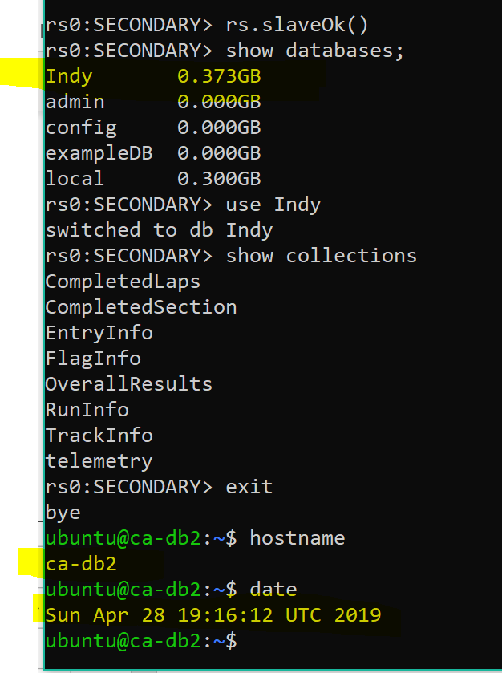
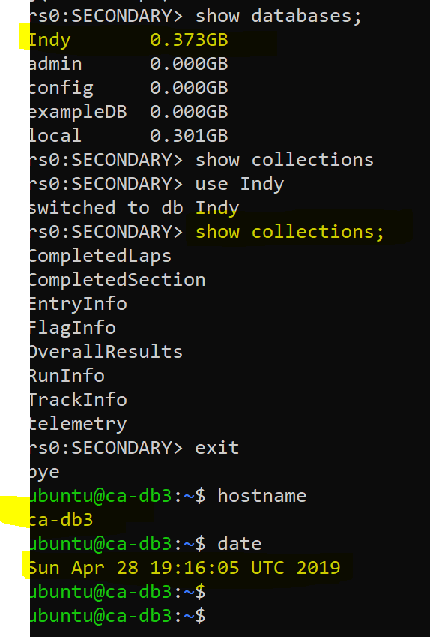
Load Balancing and Replication of the Database

Slide 11
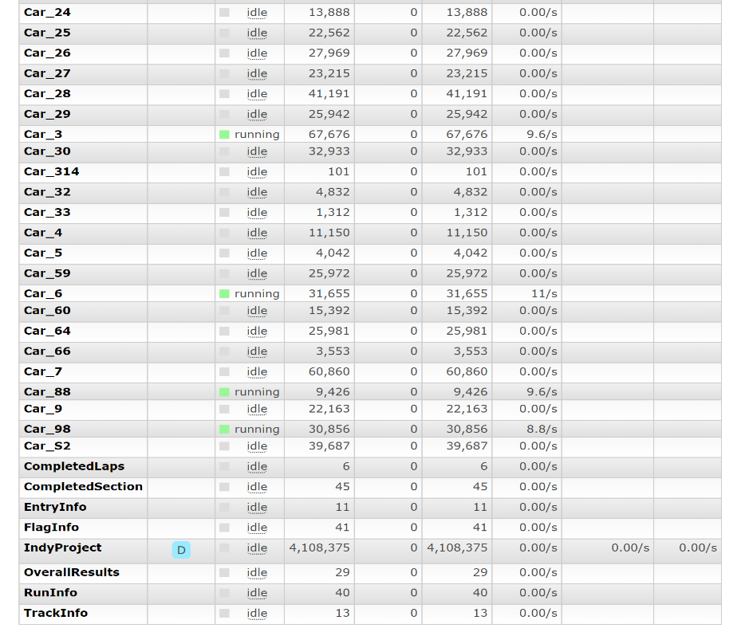
Suggested Future Work
Implementing Separate Consumers instead of a single consumer.
Implementing a Monitoring Tool for IndyCar Project

Slide 12
Conclusion and Observation
Inconsistency in $P record fields
Inconsistency in the order of receiving the records (Eg- $O records)
Inconsistency in timing (difference between $H and $P time scheme)
From the benchmark experiments, we can say that Apache Apollo performed better than RabbitMQ.

